Slide 1
English paper piecing!!
Alex Wingate
DH Methodz
Nov. 10, 2024

Slide 2
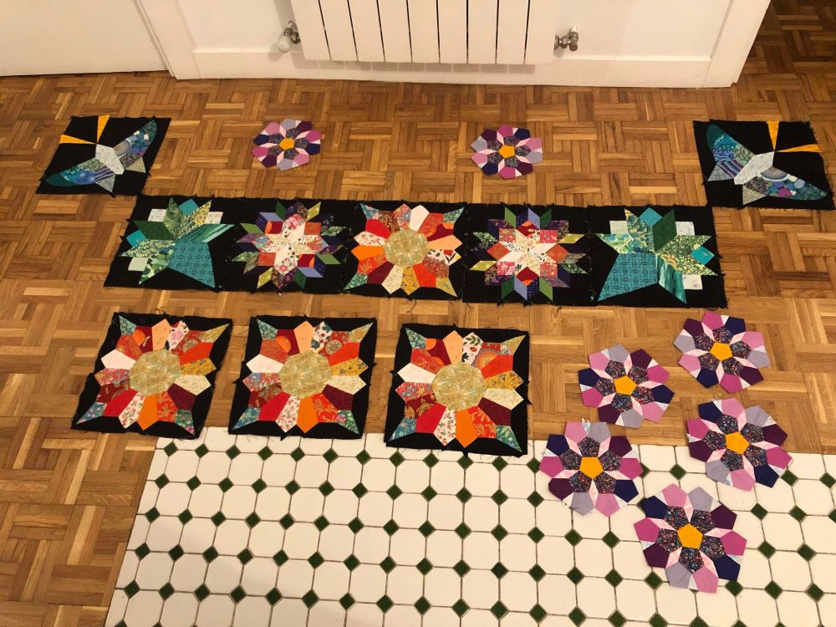
What is it?
Technique for piecing (putting fabric pieces together) for quilting
Fabric is wrapped around shaped pieces of paper and attached using glue or thread
Fabric covered pieces sewn together to form a tessellated fabric surface
Can do with sewing machine or thread and needle

Slide 3
Steps
Choose shapes and make sure design fits together without gaps (tessellates)
Graph paper or computer programs can help with this
Cut fabric so there is at least 3/8” extra fabric on all sides of paper piece (don’t need to be exact)
Wrap fabric around paper piece (wrong side against paper), securing (basting) with glue or thread
Hold two pieces right sides together (side where fabric fully covers paper)
Sew pieces together on side where want them to attach
Hand whipstitch: needle goes in perpendicular to the pieces from the same side every time. Diagonal line formed on top
Machine blind-hem stitch: needle should just catch the edge
Keep sewing pieces together. When a piece is enclosed on all sides by other pieces, can pop out paper piece
When whole surface is finished, pop out all pieces and press seams (iron goes up and down)

Slide 4
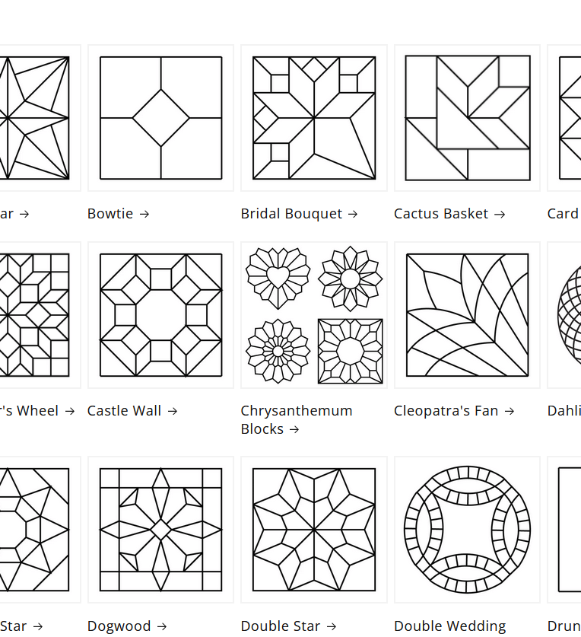
Basic supplies
Stiff-ish paper for the pieces (heavier than copy paper, cardstock at max heaviness)
Cut yourself: can cut by hand (hard to get accurate), special hole punches for shapes (hurts your hand after a while), machines like Cricut (have to get machine)
Order pieces: paperpieces.com (are laser cut; lots of sizes available), others likely exist.
Thread: any type, but goal is to get colors that blend with pieces being sewn
Needles: any type, but I really like Tulip Piecing Needles
Fabric: woven, non-stretch fabric. Quilting cotton most typical.
Cutting implement: scissors or rotary cutter to cut fabric
Glue (if doing glue basting): can use purple craft glue sticks. I prefer Sew-line fabric glue because it is archival quality. I think it’s worth it in the long run.
Iron: for pressing at end

Slide 5
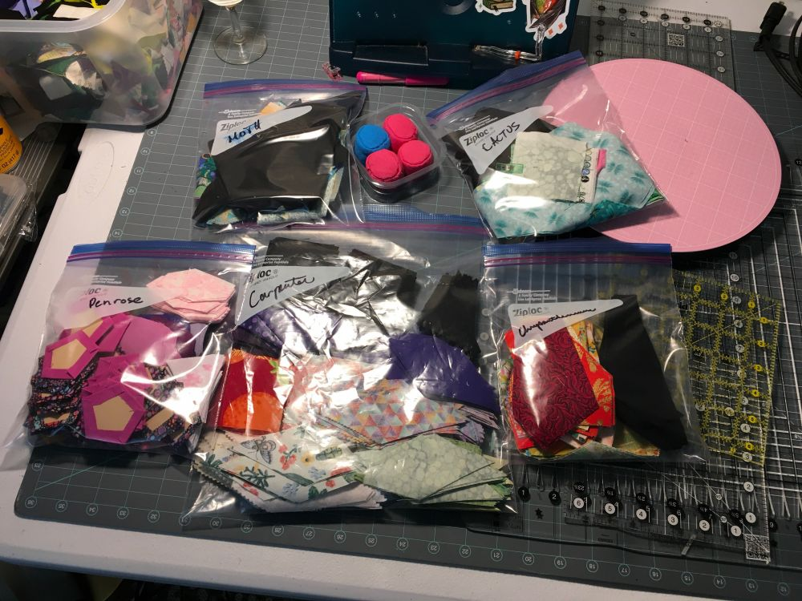
Optional but useful supplies
Small magnets: hold the pieces you’re sewing together so you don’t have to grip so hard
Sew Tites: multiple sizes, more expensive
Badge magnets and hijab magnets: multiple sizes, cheap!
Thimble: if you hand sew, you will want one eventually
Leather thimble: Clover’s is my preference, but I doctored mine up
Metal thimble
Bandaid: works amazingly well, but can’t reuse
Templates: for fussy cutting fabric
Can buy or 3D print!
Good lamp: to keep your eyes from going
Plastic bags or containers: useful for organizing wrapped pieces, unwrapped fabric, and paper pieces
Utility chopstick/dowel: useful for popping out pieces and while ironing

Slide 6
Quick demo!

Slide 7

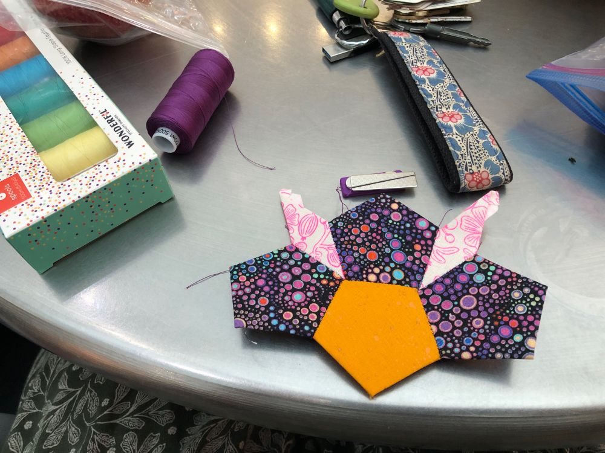
Why do I like it?
Two words: FABRIC LEGOS!!!
Way easier to get good points and intricate designs
Don’t have to exact while cutting fabric
Accurately sized and cut paper gives you preciseness
Can be done with machine or hand sewing
Good for using up scraps
Portable!
Easily put-down-able at all steps in process
Finished piece can be any shape and any size so can do little things and big things

Slide 8

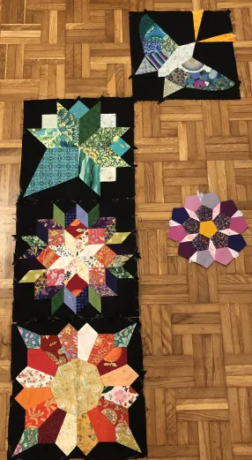
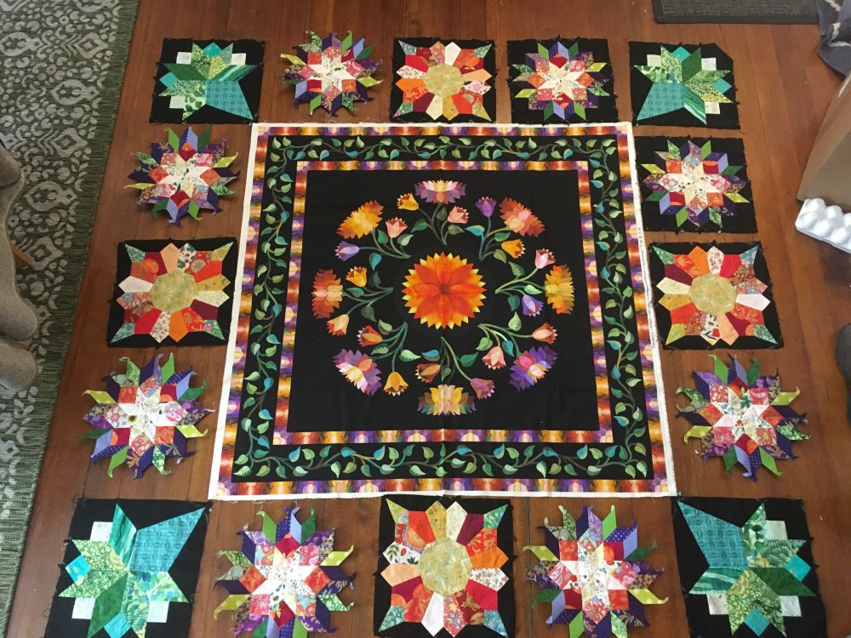
Current project!

Slide 9
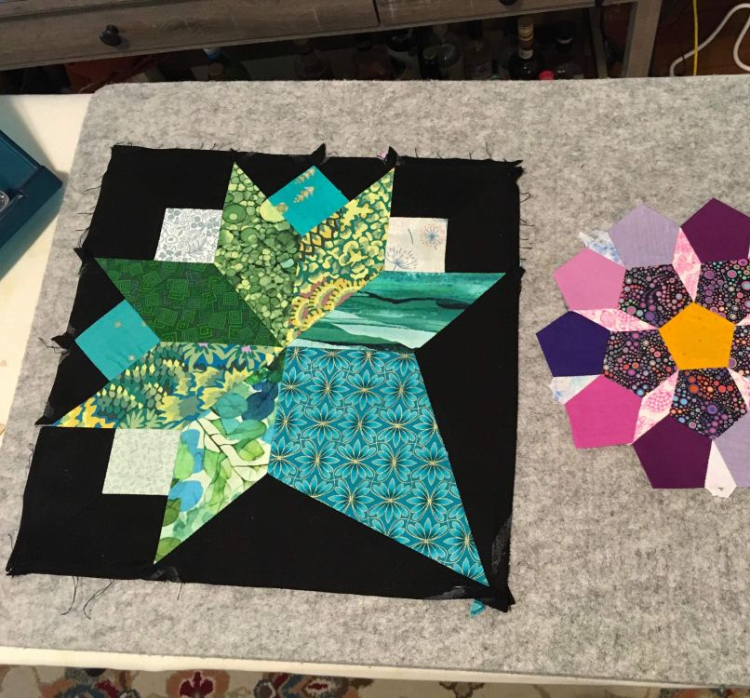
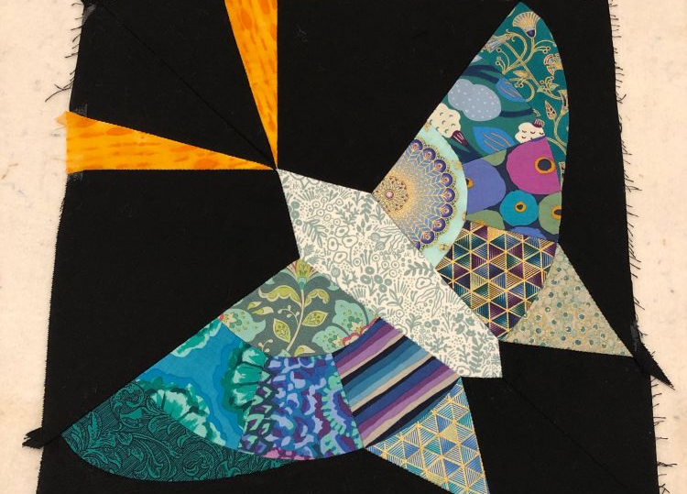

Slide 10
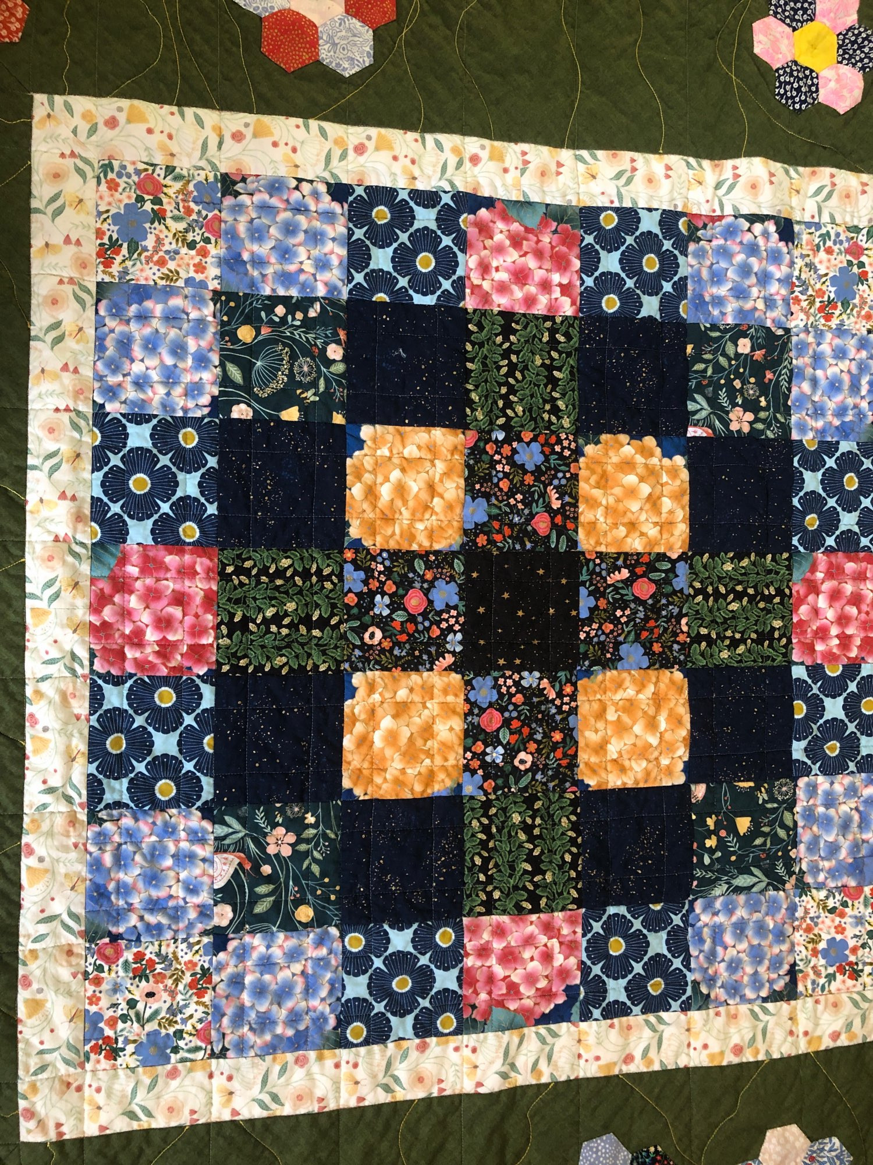
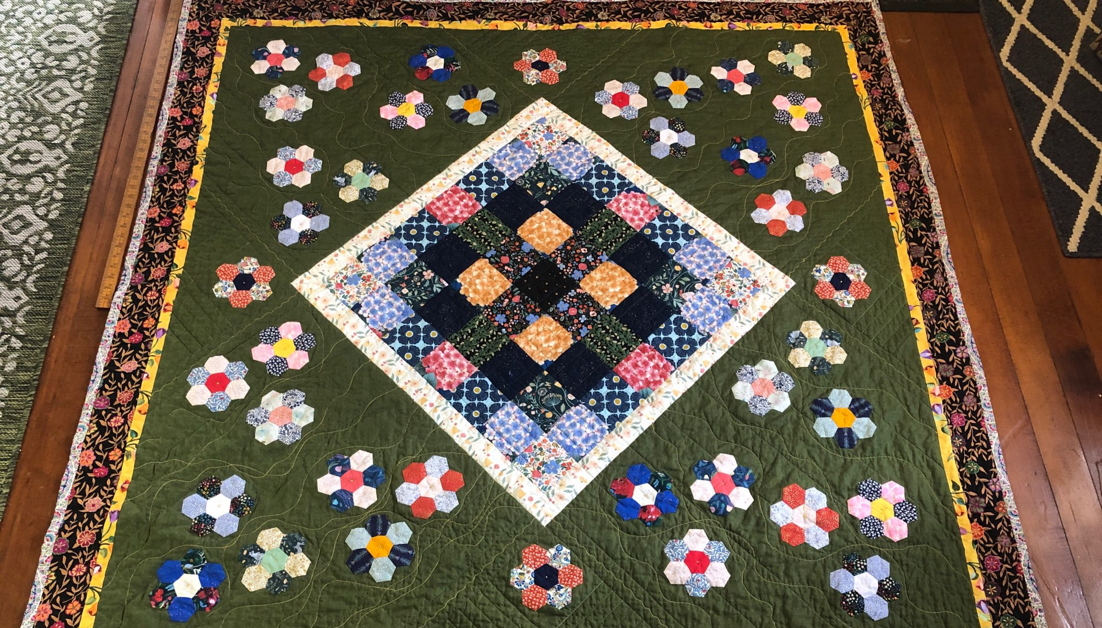
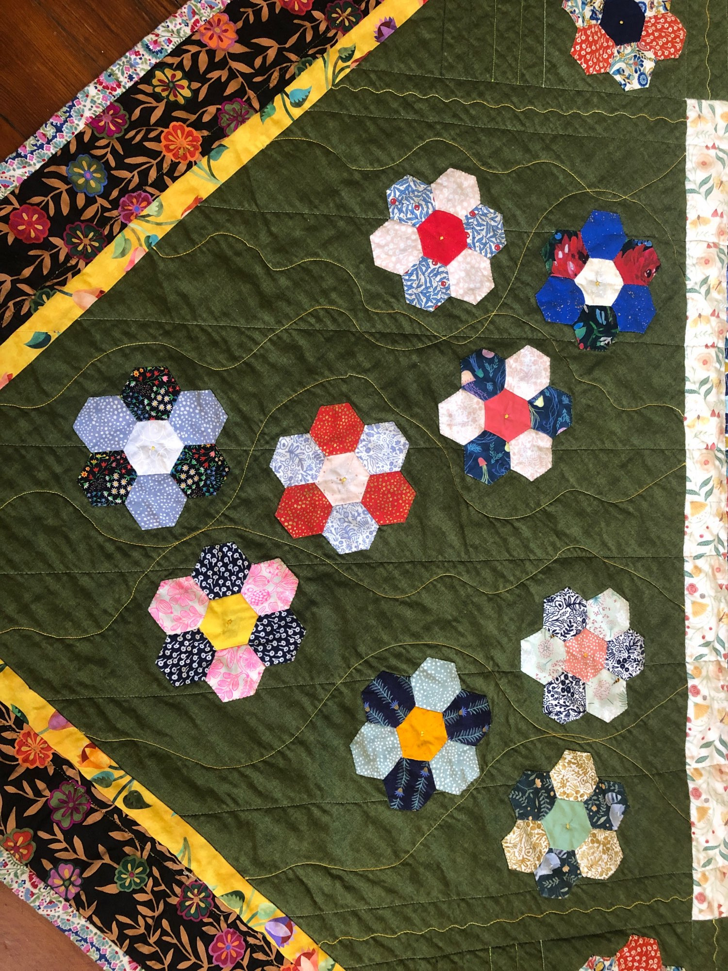

Slide 11
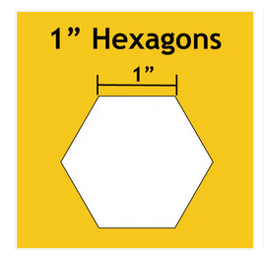
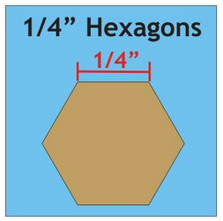
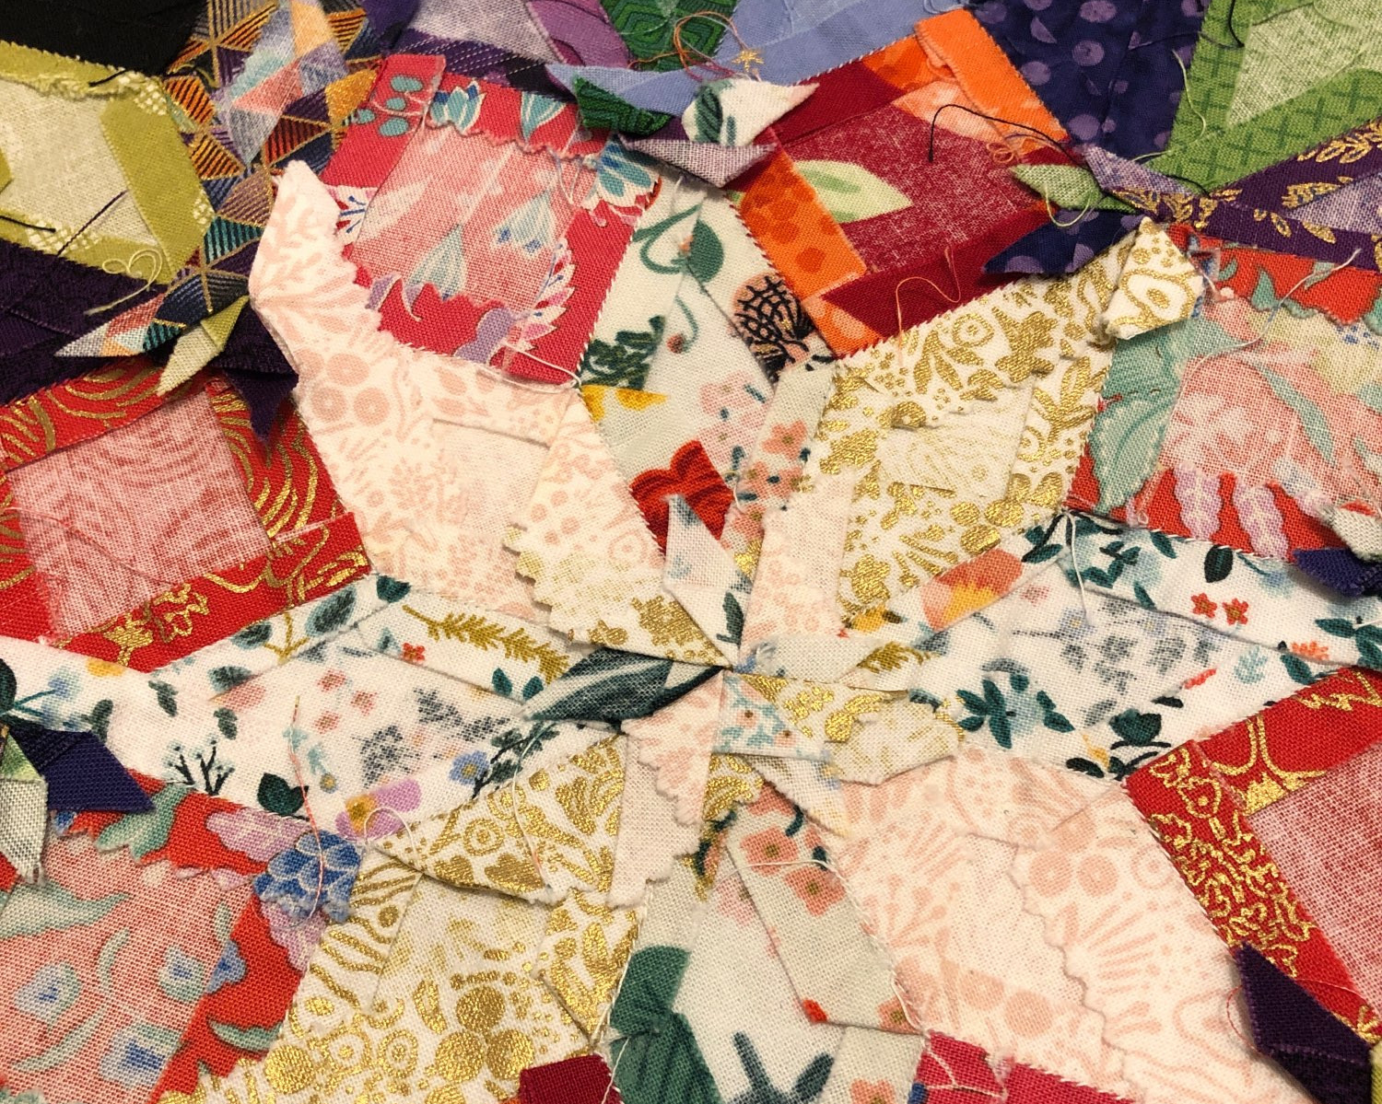
Things to remember & Troubleshooting
Paper sizes
The size of a paper piece is always referred to by the length of the sides. A 1-inch hexagon means each side is 1 inch long, not that the piece is 1 inch across at widest point. Makes it easier to match side lengths
Basting
Big pieces, thin, and/or curved pieces are harder to glue baste
Glue may need to be re-applied if pieces sit for a long time. Fabric will start detaching
Wrapping
Can’t wrap too tight because could bend paper
Can’t wrap too loose because lose crisp edge and piecing
Getting pieces to line up
Even with careful wrapping and laser cut pieces, stuff might not line up
Stitches showing
Match thread better
Smaller, tighter stitches

Slide 12
Resources
Tula Pink Tutorial series on YouTube
Part 1 on Cutting Fabric
Part 2 on Supplies
Part 3 on Sewing
Glue basting
Good tips for how to sew
All Points Patchwork by Diane Gilleland
$20 on Bookshop.org
Check your public library!!
Detailed instructions for thread basting, but no glue basting
Lots of tips for how to wrap different types of shapes and how to put them together
Good section on troubleshooting
Young & Millennial Quilters
Really nice Facebook quilting group!

